Slide 1
Testing and Debugging
CS221 – 2/13/09

Slide 2
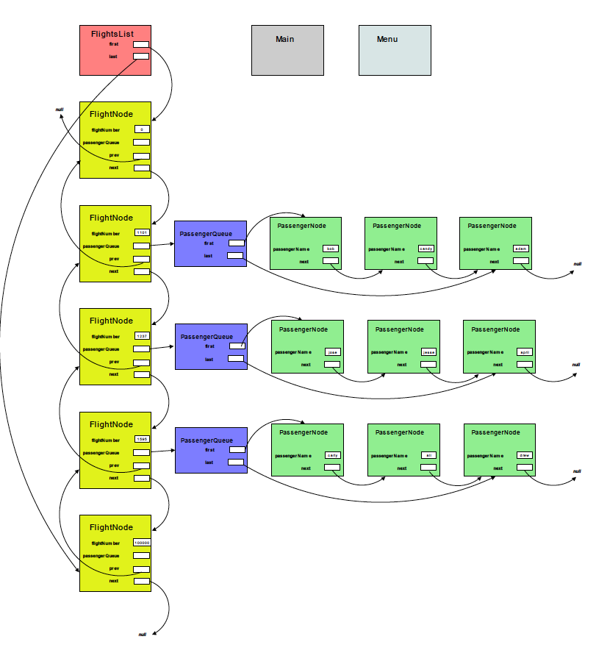
Airline Program

Slide 3
Why do we test?
To discover logical errors
To reduce defects
To gain confidence in your system
To prove it performs according to specification
To reduce risk
Testing is a form of Risk Assessment

Slide 4
Creating software is hard
Even experienced developers struggle
Every line of code can have multiple bugs
Every problem has multiple solutions
Some elegant
Some not so elegant
Writing simple, working code will always be a challenge
Writing code is like writing a book but…
Getting a sentence wrong can cost your business $100M
If it was easy, everyone would be doing it!

Slide 5
Not convinced?
Consider the complexity of a Boeing 747
Software can’t be subjected to physical analysis and testing
Software interactions can’t be ‘seen’ in the real world
A modern operating system has 50 million lines of code or more
Each line can have 1 or more defects.
A 747 has 6 million parts. 3 million of which are fasteners.
You tell me: 50MLOC >= Boeing 747?

Slide 6
Testing is just as hard
Defect scope varies
Line
Method
Class
Thread
Process
System
Difficult to get complete code coverage
Impractical to get 100% coverage of paths + data
Proving a system is defect free is impossible in the real world

Slide 7
Steps to reduce defects
Understand your specification
Think first – plan and design your code
Mentally step through how your code should work before writing it
Manually inspect each block of code
Test each block as soon as it is testable
Step through complex code with the debugger
Write unit tests to automate your testing
Use integration tests to test method interactions
System test as soon as it is testable
Use acceptance tests to demonstrate the system is ready for users

Slide 8
Real world best practices
Unit tests on every code change
Unit tests + integration tests on every check-in
Unit tests + integration tests + system tests on every build
Unit tests + integration tests + system tests + acceptance tests on every major milestone
Automation makes the difference between an agile team and a team that can’t hit deadlines

Slide 9
Unit Testing
Always automated
Extremely granular
Test each method in isolation if possible
Test the class as a whole if necessary
JUnit – Java unit testing framework built into Eclipse

Slide 10
Integration Testing
Less granular than unit testing
Test the interaction of classes to make sure they work well together
Integration Test Drivers: You can write your own or use a framework

Slide 11
System Testing
Test the entire system with user scenarios in mind
For instance: test across multiple application tiers (client, app server, database server)
Usually requires some manual testing plus a UI automation test framework
Programmatic interfaces can be more easily tested
For instance: a web service vs. a web application.

Slide 12
Acceptance Testing
The final testing phase, used as an exit-criteria
Used as a means to ‘sign-off’ on a build for a major milestone
Alpha, Beta, Release
Defines the criteria by which the software is deemed acceptable to pass the milestone

Slide 13
Black and White
Black Box Testing
Test without access to source or program internals
Test the interface from the user perspective
Vary the inputs, see if the outputs match expectations
Interface you are testing could be:
Public methods on a class
Public interface on a component
Network interface
User interface
Techniques
Automated drivers
UI automation tools
Dynamic analysis scanning tools
Manual testing

Slide 14
Black and White
White Box Testing
Test with knowledge of program internals
Use internal knowledge to maximize code coverage
Hit success paths as well as failure paths
Techniques
Manual code review
Use the debugger
Instrument the code to force paths
Static analysis tools
Automated drivers

Slide 15
How to make testing easier
Comments
On interfaces
On methods
Each parameter
Return values
Describe complex code blocks
Defined pre and post conditions
What you expect from your caller
What they should expect from you
Simplify
Think of the cost of testing when you develop your code
Simple code is much easier to test than complex

Slide 16
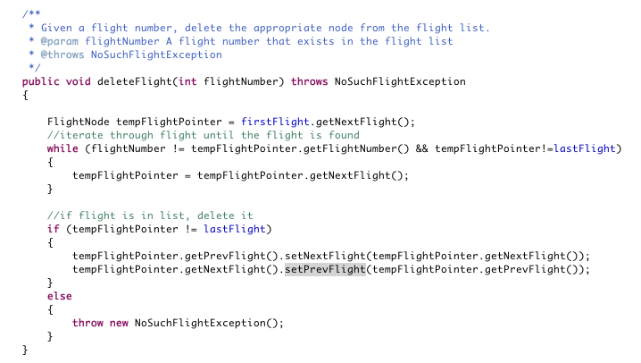
Comment Example

Slide 17
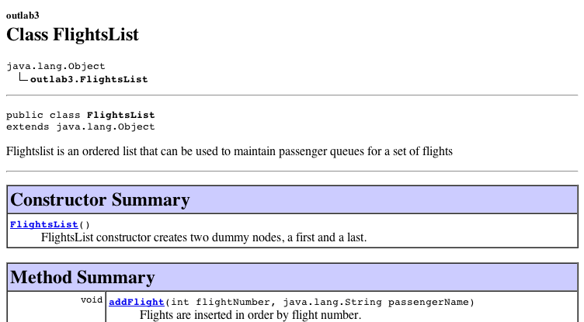
Comments
Previous example is probably over-commented
In general
Use comprehensive commenting on methods and classes
Line-level comments are not too useful unless the code is very tricky
/** comments have a valuable side-effect */

Slide 18
Pre and Post Conditions
You can put the post condition in the description and/or the @return comment
You can put the pre conditions in the @param comments
/**
* Given a flight number, delete the appropriate node from the flight list
* @param flightNumber A flight number that exists in the flight list
* @throws NoSuchFlightException
*/

Slide 19
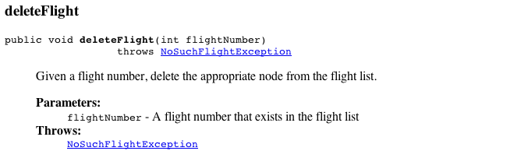
Pre and Post Conditions

Slide 20
Simplify
Statement coverage requires you hit every statement in your source code
Branch coverage requires you hit each choice on each branch
Path coverage requires you hit every possible combination of statements in your code
Every class, method, parameter and conditional statement adds complexity
For instance path coverage is 2^N (exponential) where N is the number of conditional statements
5 if statements = 32 paths
10 if statements = 1024 paths
100 if statements = 1.27E30 paths
Cyclomatic complexity: http://en.wikipedia.org/wiki/Cyclomatic_complexity
Some great tips: http://www.squarebox.co.uk/download/javatips.html

Slide 21
Test Driven Development
Develop your test cases first, then implement your code
Tests become a part of the specification
The code is implemented from the ground-up to pass the tests
Any changes to the code requires a re-run of the tests
Airline Program example
Design your class/method structure (FlightNode, FlightList, etc)
Stub out your public methods
Create JUnit tests (Add a flight, enqueu a passeger, dequeue a passenger, delete a flight, etc)
As each class is implemented, the tests should start to pass
You know you are done when all the tests pass

Slide 22
Team Roles
Developer: Write the code and test to make sure it works
Tester: Assess risk to the business if this code was released
The days of throwing your code over a wall to a test team are over
A developer who cannot test his own code won’t last
Modern software development organizations expect high quality code on the first try
If you are working with a tester, expect them to find nasty, complex problems before your users do
Do not expect a tester to clean up your mess

Slide 23
What should you put in your tests?
Focus on hitting each branch
Equivalency classes
Boundary conditions
Make sure you understand what results to expect (pass/fail)
Path coverage is much harder – leave it to integration and systems testing

Slide 24
Equivalency Classes and Boundaries
Equivalency class = A set of inputs that will result in the same branch execution
Boundary condition = A set of inputs that will test the edges of a branch condition
Together = Pick test inputs that execute each branch using the most extreme edge value

Slide 25
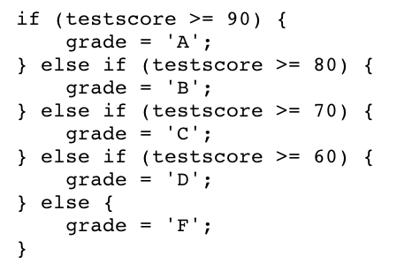
Example

Slide 26
Example

Slide 27
Putting it all together
JUnit API Docs - http://junit.org/junit/javadoc/4.5/
Create a JUnit file for each class
Use setup() if you need to set up the state of your object
Call each of the class methods you want to test
Any exception or failed assertion will fail the test
Use tearDown() if you need to clean up after testing

Slide 28
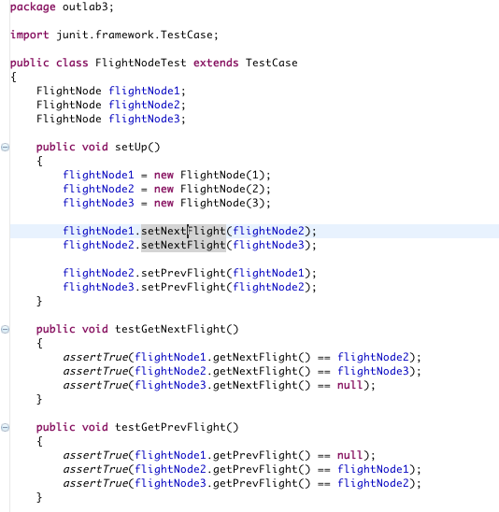
Example

Slide 29
Debugging
Breakpoints
Line: Stops execution on the specified line
Method: Stops execution on the method
Watchpoint: Stops execution whenever the field is accessed or modified
Exception breakpoint: Stops execution when an exception is thrown
Class load breakpoint: Stops execution when a class is loaded

Slide 30
Debugging
Step in: Steps into the method being called
Step over: Steps over the method being called
Step return: Steps out to the calling method
Run to line: Executes until the specified line of code

Slide 31
Debugging Tips
Use inspect or variables window to see object values
Use breakpoints and step through code that is complex – make sure it works as you expect it
You can make changes to the code while debugging but it won’t affect execution till you restart
Breakpoints on each branch will quickly tell if you have good branch coverage
Use assertions to check boundary conditions/assumptions in your code
Assertions check logical assumptions
Assertions only work if –ea is on compile command line

Slide 32
Key Points
Purpose of testing is to understand and reduce risk
Unit/Integration/System/Acceptance
Use JUnit tests to automate granular testing on methods and classes
Black Box vs. White Box
Write code with testing cost in mind
Test Driven Development
Build your tests first, then implement your solution
Use equivalency classes and boundary conditions to drive your testing
The debugger is your friend
The more time you spend stepping through code, the better your understanding will be

